Slide 1
Randomized Algorithms CS648
Lecture 26
Concluding the course

Slide 2


Deterministic Algorithm
Randomized
Random bits
Input
Output
Algorithm
The output as well as the running time are functions of the input and random bits chosen.
or
Excess running time
on a few occasions
in Output
On a few occasions
Notes:
The output or the running time are functions of the input and random bits chosen .

Slide 3
Still why to study Randomized Algorithms ?
Efficiency
Simplicity
→……….
Deterministic algo.

Slide 4
10 MotivatiNG Examples for randomized Algorithms

Slide 5

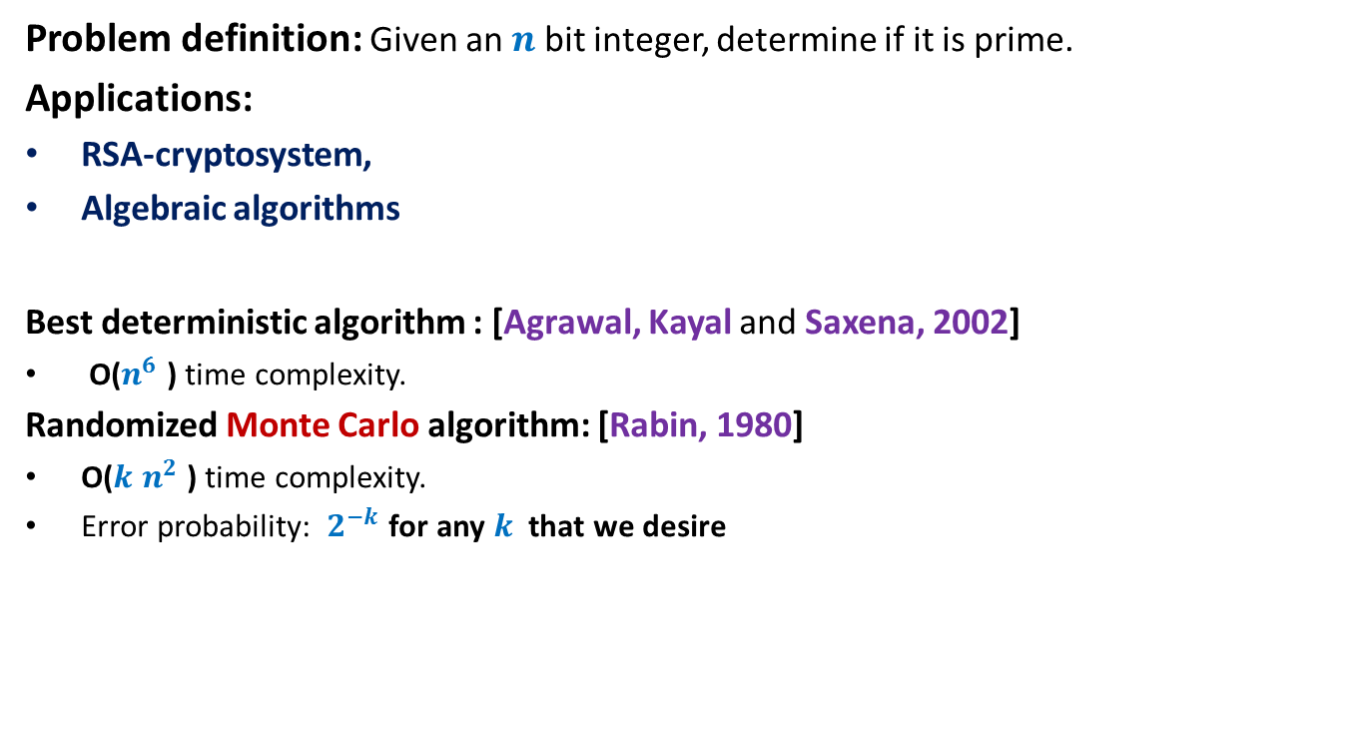
Example: Primality Testing
Problem definition: Given an $n$ bit integer, determine if it is prime.
Applications:
RSA-cryptosystem,
Algebraic algorithms
Best deterministic algorithm : [Agrawal, Kayal and Saxena, 2002]
O($n^{6}$ ) time complexity.
Randomized Monte Carlo algorithm: [Rabin, 1980]
O($k$ $n^{2}$ ) time complexity.
Error probability: $2^{−k}$ for any $k$ that we desire
For $k$= $50$, this probability is ${10}^{−15}$

Slide 6
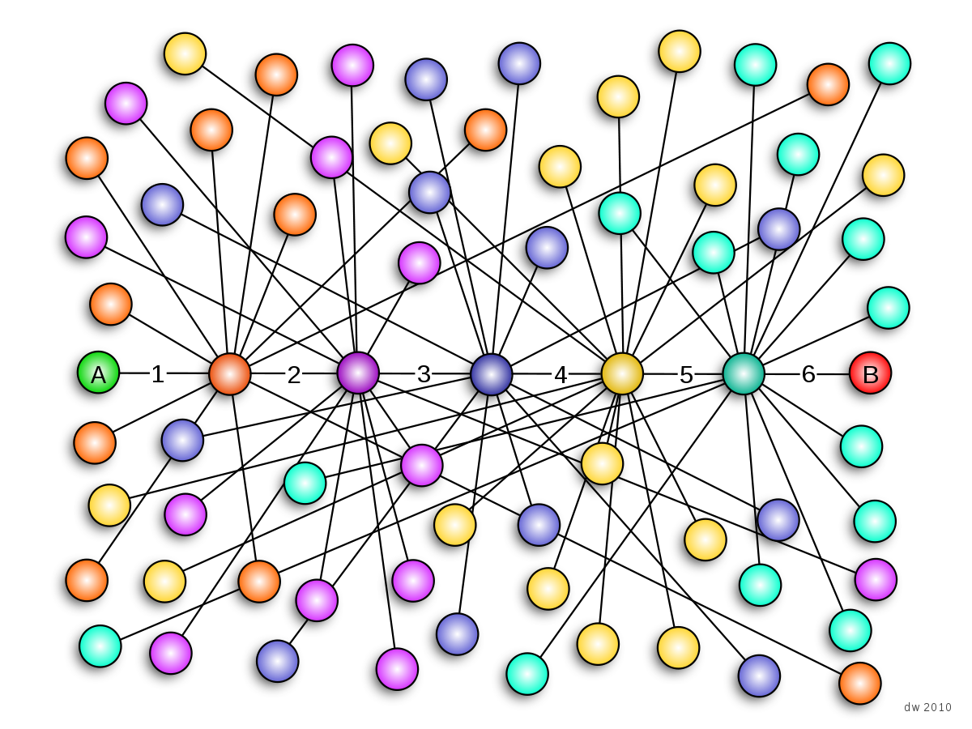
Example 5: Small world phenomenon
Any two persons in the world are connected by a chain of $5$ acquaintances.

Slide 7



$$\frac{c}{i^{2}}$$
$$v$$
$$i$$

Slide 8

$u$ and $v$ are any two nodes.
Let distance between $u$ and $v$ = $i$
P($u$, $v$) = Probability of an edge from $u$ to $v$ = $\frac{c}{i^{2}}$
$$\sum_{∀v at distance>1}{\text{P}\text{(}u\text{,} v\text{)}}=1$$
$$\sum_{i=2}^{r}{4i×\frac{c}{i^{2}}}=1$$
$$4c\sum_{i=2}^{r}{\frac{1}{i}}=1$$
$$c=\frac{1}{4\log{r}}$$

Slide 9


$$\frac{d}{2}$$
$$d$$

Slide 10
$$\frac{d}{2}$$
$$d$$

Slide 11
$$\frac{d}{2}$$

Slide 12

$$\frac{d}{4}$$

Slide 13





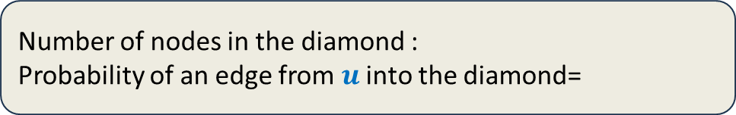


Expected No. of steps to go from $d$ to $\frac{d}{2}$
$$\frac{d}{2}$$
$$u$$
$$d$$
Number of nodes in the diamond :
Probability of an edge from $u$ into the diamond=
$$c_{2}d^{2}$$
$$\frac{c_{2}d^{2}}{4d^{2} log r }$$
$$\frac{c_{2}}{4log r }$$

Slide 14

Expected No. of steps to go from $d$ to $\frac{d}{2}$ =
$Θ(log r)$
Number of stages to reach destination =
$O\left(log r\right)$
Expected no. of steps to reach destination =
$$O\left(\log^{2} r\right)$$

Slide 15


Points to ponder over
$u$ and $v$ are any two nodes.
Let distance between $u$ and $v$ = $i$
P($u$, $v$) = Probability of an edge from $u$ to $v$ =
Exponent < $2$ won’t work
Exponent > $2$ won’t work
Real world graph : random graph
$$\frac{c}{i^{2}}$$
Power law graphs

Slide 16

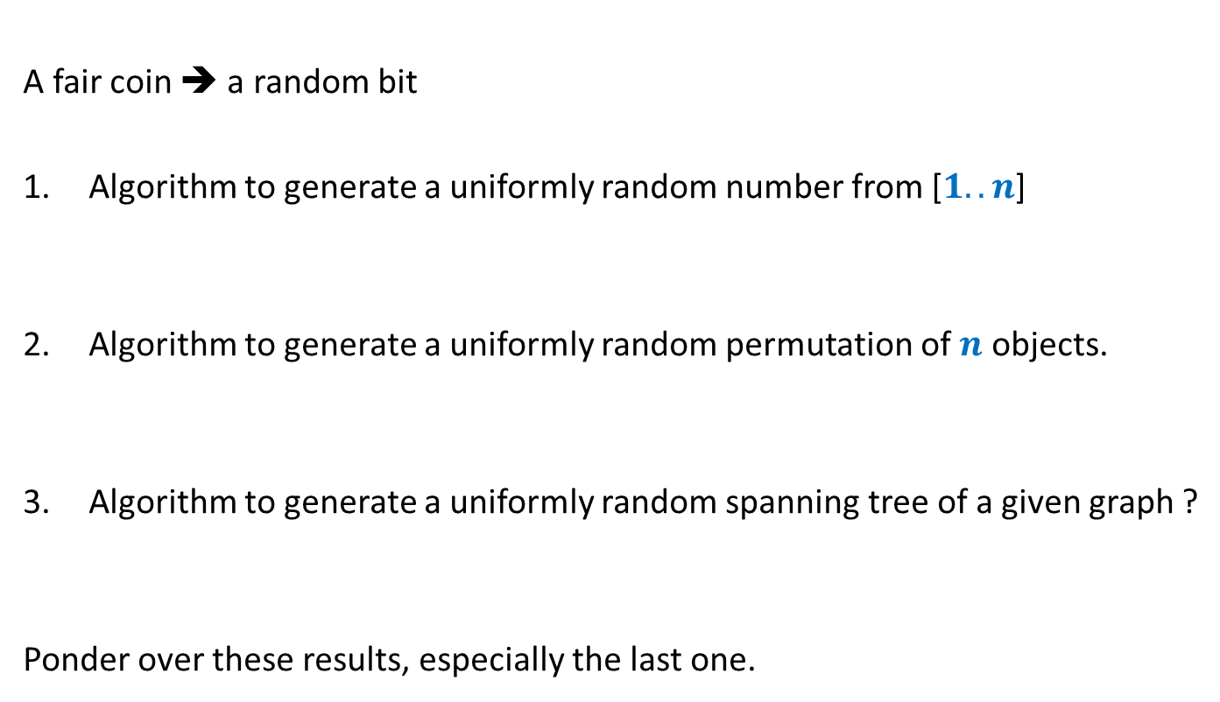

Example: Generating a random structure
A fair coin ➔ a random bit
Algorithm to generate a uniformly random number from [$1..n$]
Algorithm to generate a uniformly random permutation of $n$ objects.
Algorithm to generate a uniformly random spanning tree of a given graph ?
Ponder over these results, especially the last one.
$O(log n)$ time and $O(log n)$ random bits
$O(n log n)$ time and $O(n log n)$ random bits
A polynomial time algorithm with polynomial number of random bits.

Slide 17
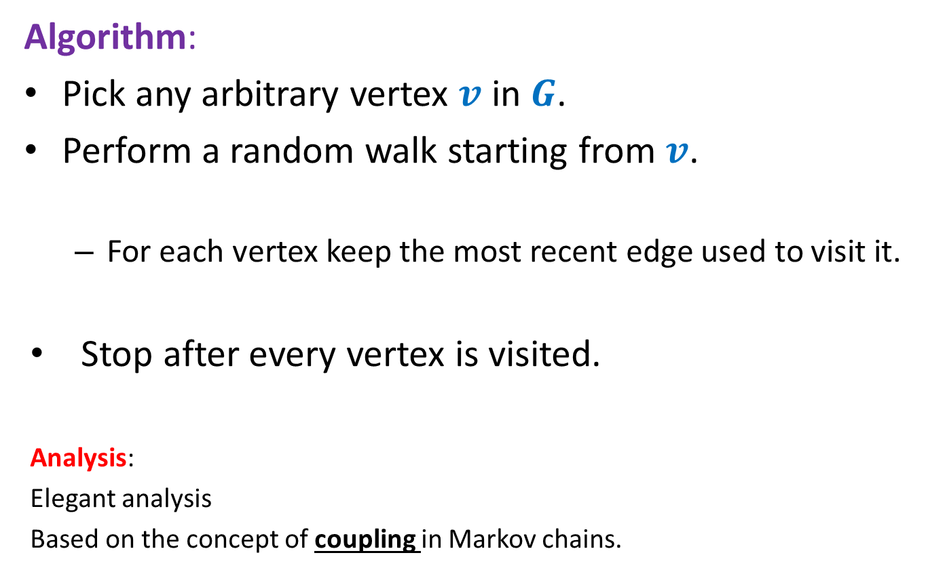
Generating a random spanning tree of a graph
Algorithm:
Pick any arbitrary vertex $v$ in $G$.
Perform a random walk starting from $v$.
For each vertex keep the most recent edge used to visit it.
Stop after every vertex is visited.
Analysis:
Elegant analysis
Based on the concept of coupling in Markov chains.

Slide 18
Card shuffling algorithm

Slide 19
Students feedback
https://oars.iitk.ac.in/oasfsiitk/
If you did an earlier course, please state if CS648 was better or worse than them (better/same/worse)
Did you like the miniproject ?
(yes or no)
Any suggestion for this course in future ?

